Slide 2
Chapter 6: Synchronization

Slide 3
Chapter 6: Synchronization Tools
OBJECTIVES
To present the concept of process synchronization.
To introduce the critical-section problem, whose solutions can be used to ensure the consistency of shared data
To present both software and hardware solutions of the critical-section problem
To examine several classical process-synchronization problems
To explore several tools that are used to solve process synchronization problems
6.1 Background
6.2 The Critical-Section Problem
6.3 Peterson’s Solution
6.4 Synchronization Hardware
6.5 Mutex Locks
6.6 Semaphores

Slide 4
Introduction
Recall
Independent process
  A process that does not share data with other processes.
  cannot affect or be affected by the execution of another process.
Cooperating process
  can affect or be affected by the execution of another process.
  processes directly share logical address space (code & data) or processes share data through files or messages.
_______________________________________________________________________________
Silberschatz, A., Galvin, P.B., and Gagne, G. Operating System Concepts (9th Edition). John Wiley & Sons: Asia. (2014) Page 120.

Slide 5
6.1 Background
Concurrent access: accessing of the same data at the same time by more than one process, thus:
  Concurrent access to shared data may result in data inconsistency
  Maintaining data consistency requires mechanisms to ensure the orderly execution of cooperating processes
  Race Condition: problem in concurrent execution
The synchronization mechanism is usually provided by both hardware and the operating system
Illustration of the problem – The producer-Consumer problem.
Basic assumption – load and store instructions are atomic.

Slide 6
Why a Race Condition Occurs?
6.1
Background
  Two processes may be :
    executing simultaneously, and
    trying to access the same global variable.

Slide 7
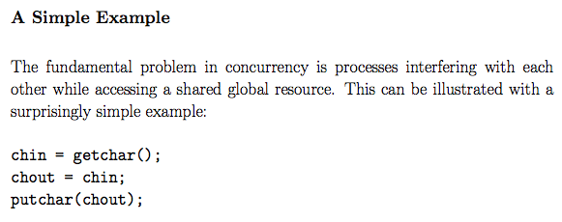
http://undergraduate.csse.uwa.edu.au/units/CITS2230/handouts/Lecture09/lecture9.pdf

Slide 8

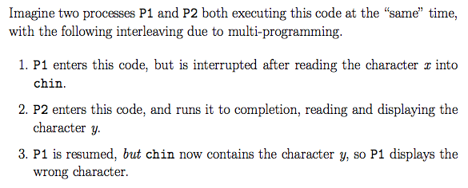

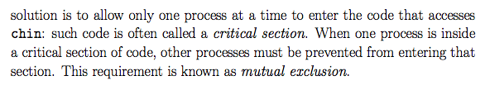
Critical section
Mutual exclusion

Slide 9
Producer-Consumer Problems
Several processes work together to complete common task – Process Cooperation
Common paradigm for cooperating processes, producer process produces information that is consumed by a consumer process.
  Examples:
  The compiler produces an assembly code which is consumed by an assembler.
  The web server provides HTML files which is consumed by the client web browser requesting the resource.

Slide 10
6.1
Suppose that we wanted to provide a solution that fills all the buffers where we allow the producer and consumer processes to increment and decrement the same variable.
We can do so by adding another integer variable –
a counter that keeps track of the number of full buffers.
Initially, counter = 0.
The variable counter, is incremented by the producer after it produces a new buffer and is decremented by the consumer after it consumes a buffer.
The code is shown in the next two slides

Slide 11
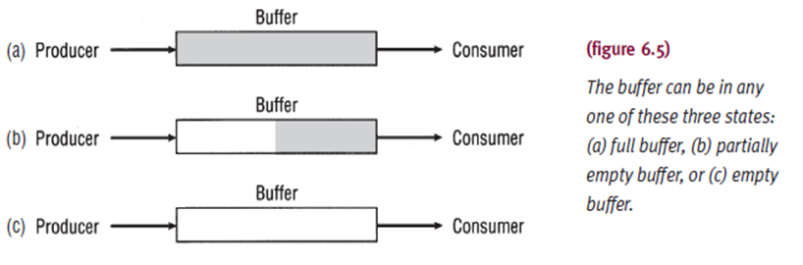
To enable producer and consumer to be executed concurrently, a buffer (shared memory) is used for producer to put data while consumer access it.
  unbounded-buffer provides unlimited buffer size.
  bounded-buffer assumes that there is a fixed buffer size.

Slide 12

Producer puts data in one slot while consumer retrieve data from another slot.
Producer and consumer need to be synchronized so that consumer will not retrieve data before producer puts the data into the buffer.
Therefore,
  producer needs to wait if buffer is full
  consumer needs to wait if buffer is empty

Slide 13
Producer Process
while (true) {
/* produce an item in next produced */
while (counter == BUFFER_SIZE) ;
/* do nothing */
buffer[in] = next_produced;
in = (in + 1) % BUFFER_SIZE;
counter = counter +1;
}

Slide 14
Consumer Process
while (true) {
while (counter == 0)
; /* do nothing */
next_consumed = buffer[out];
out = (out + 1) % BUFFER_SIZE;
counter = counter - 1;
/* consume the item in next consumed */
}

Slide 15
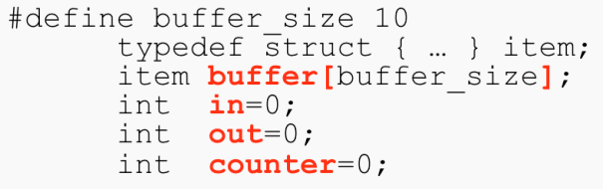
Bounded-Buffer Problems
Shared Variables
  in, out, counter and buffer[ ]
  Initial values for in, out, counter =0
Both routines are correct if executed independently.
However, it may give problem if run concurrently when the processes are not synchronized properly.
(For Slide page 21-24:_________________________________________________________________
Silberschatz, A., Galvin, P.B., and Gagne, G. Operating System Concepts (8th Edition). John Wiley & Sons: Asia. (2010) Page 254.

Slide 16
Buffer [6]
Producer
Consumer
If current counter = 5 and statements:
    counter ++ 🡪 (producer)
    counter -- 🡪 (consumer)
are executed concurrently . . .
  Then the counter maybe 4, 5 or 6.
  The correct value is 5 (synchronized properly)

Slide 17
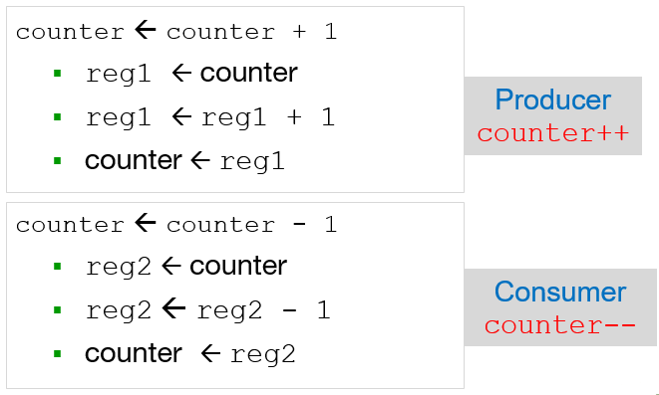
Each statement consists of several machine instructions:

Slide 18
Race Condition
counter = counter + 1 could be implemented as
register1 = counter
register1 = register1 + 1
counter = register1
counter = counter -1 could be implemented as
register2 = counter
register2 = register2 - 1
counter = register2
Consider this execution interleaving with “count = 5” initially:
  S0: producer execute register1 = counter {register1 = 5}
  S1: producer execute register1 = register1 + 1 {register1 = 6}
  S2: consumer execute register2 = counter {register2 = 5}
  S3: consumer execute register2 = register2 – 1 {register2 = 4}
  S4: producer execute counter = register1 {counter = 6 }
  S5: consumer execute counter = register2 {counter = 4}
Synchronize problem (race condition)

Slide 19
Race Condition - Definition
Def 1: A situation whereby at least two processes perform some operations on shared data and the outcome depends on the order of data access.
Result of process must be independent of the speed of execution of other concurrent processes;
  Depend on the control / data synchronization mechanisms.
Def 2: A situation whereby multiple threads access a data item without coordination in a multithreaded application.
possibly causing inconsistent results (depending on which thread reaches the data item first).
* (Multithread normally access / used shared variables)
_______________________________________________________________________________
Silberschatz, A., Galvin, P.B., and Gagne, G. Operating System Concepts (9th Edition). John Wiley & Sons: Asia. (2014) Page 255.

Slide 20
Solution to Race Condition
Ensure that only one process at a time can manipulate the shared variable (eg. Counter)
Therefore process synchronization is needed.
  means coordinating the activities of two or more processes.
Synchronization is necessary to ensure that interdependent code is executed in the proper sequence.

Slide 21
Race Condition (Cont.)
How do we solve the race condition?
We need to make sure that:
  The execution of
  counter = counter + 1
  is executed as an “atomic” action. That is, while it is being executed, no other instruction can be executed concurrently.
  Similarly for
  counter = counter - 1
The ability to execute an instruction, or a number of instructions, atomically is crucial for being able to solve many of the synchronization problems.

Slide 22
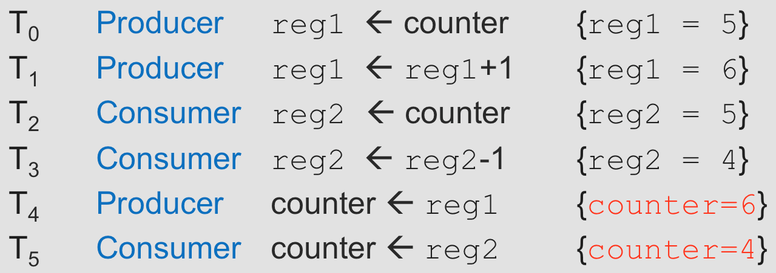
Extra
Exercise 6.1:
Based on a several machine instructions below that has synchronization problem, give your suggestion on how to overcome that race condition situation.

Slide 23
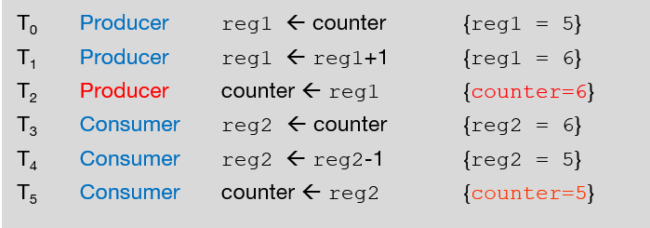
Extra
Solution 6.1:
Producer should update the counter just before consumer read the value of counter.

Slide 24
6.2 Critical Section Problem
Part of a program (segment of code for each process)
Consider system of n processes {P₀, P₁, … P_{n-1}}
Each process has critical section segment of code
  Process may be changing common variables, updating table, writing file, etc
  When one process in critical section, no other may be in its critical section
Critical section problem is to design protocol to solve this.
Each process must ask permission to enter critical section in entry section code; it than executes in the critical section; once it finishes executing in the critical section it enters the exit section code. The process then enters the remainder section code.

Slide 25
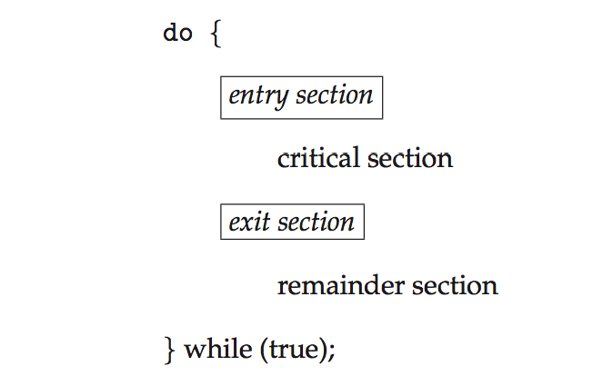
General structure of Process Entering the Critical Section
General structure of process P_{i}
Figure 6.1 General structure of Process Entering the Critical Section

Slide 26
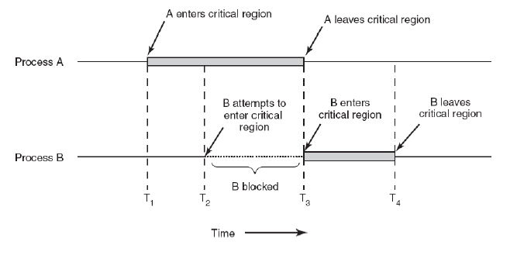
CS – Process Structure

Slide 27
Algorithm for Process P_{i}
Entry section to critical section is to “disable interrupts.
Execute in the critical section
Exit section is to “enable interrupts”.
Implementation issues:
  Uniprocessor systems
    Currently running code would execute without preemption
  Multiprocessor systems.
    Generally too inefficient on multiprocessor systems
    Operating systems using this not broadly scalable
Is this an acceptable solution?
  This is impractical if the critical section code is taking a long time to execute.

Slide 28
Algorithm for Process P_{i}
Have a variable “turn” to indicate which process is next
do {
while (turn == j);
critical section
turn = j;
remainder section
} while (true);
Figure 6.2
Algorithm is correct. Only one process at a time in the critical section.
The other process will do Busy waiting for until the current process finish its critical section.

Slide 29
Requirements for CS solutions
6.2
Assumptions:
Assume that each process executes at a non-zero speed
No assumption concerning relative speed of the n processes or #number of CPU.
Mutual Exclusion
The algorithm does satisfy the three essential criteria to solve the CS problems.
Progress
Bounded Waiting

Slide 30
Solution to Critical-Section Problem
Must satisfy the following three requirements:
1. Mutual Exclusion - If process P_{i} is executing in its critical section, then no other processes can be executing in their critical sections
2. Progress - If no process is executing in its critical section and there exist some processes that wish to enter their critical section, then the selection of the processes that will enter the critical section next cannot be postponed indefinitely
3. Bounded Waiting - A bound must exist on the number of times that other processes are allowed to enter their critical sections after a process has made a request to enter its critical section and before that request is granted
  Assume that each process executes at a nonzero speed
  No assumption concerning relative speed of the n processes

Slide 31
4 Types of locking mechanisms to solve CS problem:
1. Software defined (Strict Alternation, Flagging and Peterson)
2. Hardware support (Test-and-set and swap)
3. Support from the Operating System (Semaphore)
4. Support the programming language (Ada – rendevous)

Slide 32
6.3 Software Solution: Peterson’s Algorithm
Good algorithmic software solution
Two process solution
Assume that the load and store machine-language instructions are atomic; that is, cannot be interrupted
The two processes share two variables:
  int turn;
  Boolean flag[2]
The variable turn indicates whose turn it is to enter the critical section
The flag array is used to indicate if a process is ready to enter the critical section. flag[i] = true implies that process P_{i} is ready!

Slide 33
Algorithm for Process P_{i}
do {
flag[i] = true;
turn = j;
while (flag[j] && turn = = j);
critical section
flag[i] = false;
remainder section
} while (true);
Provable that the three CS requirements are met:
1. Mutual exclusion is preserved
P_{i} enters CS only if:
either flag[j] = false or turn = i
2. Progress requirement is satisfied
3. Bounded-waiting requirement is met
Figure 6.2 The structure of Process P_{i} in Peterson’s Solution

Slide 34

Exercises 1
Rewrite the Peterson's algorithm for CS solution for process 0 (P₀).
Rewrite the Peterson's algorithm for CS solution for process 1 (P₁).
P₁
P₀

Slide 35
Answer
Initial SHARED values:
flag[0] = FALSE flag[1] = FALSE
do {
flag[0] = TRUE;
turn = 1;
while(flag[1] && turn == 1)
; /* do nothing */
critical section
flag[0] = FALSE;
remainder section
} while (TRUE);
do {
flag[1] = TRUE;
turn = 0;
while(flag[0] && turn == 0)
; /* do nothing */
critical section
flag[1] = FALSE;
remainder section
} while (TRUE);
P₀
P₁
Initially the flags are false. When a process wants to execute it’s critical section, it sets it’s flag to true and turn as the index of the other process. This means that the process wants to execute but it will allow the other process to run first. The process performs busy waiting until the other process has finished it’s own critical section.
After this the current process enters it’s critical section and adds or removes a random number from the shared buffer. After completing the critical section, it sets it’s own flag to false, indication it does not wish to execute anymore.

Slide 36
"I am ready to enter CS" flag[0]=true;
“But you can execute your own CS" turn=1;
"If you are ready to enter and while(flag[1]==true&&turn==1){
it's your turn I'll wait.“ /*P0 wait*/ }
Otherwise, I’ll enter my CS CS
"I don't want to enter any more." flag[0]=false;
P₀
Entrance to the CS is granted for process P₀
if P₁ does not want to enter its CS,
flag[1]=FALSE
or
if P₁ has given priority to P₀ by setting turn=0.

Slide 37
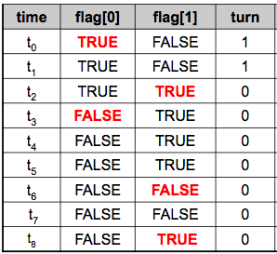
Exercises 2
What is the event for each t_{i} if 2 concurrent processes wishing to enter their CSs.
Check if the following is preserved:
  Mutual exclusion
  Progress
  Bounded Waiting

Slide 38
Answer: Execution of algorithm
P₀
P₁
time | flag[0] | flag[1] | turn | Events
t₀ | TRUE | FALSE | 1 | P₀ request to enter CS₀
t₁ | TRUE | FALSE | 1 | P₀ enters CS₀
t₂ | TRUE | TRUE | 0 | P₁ requests to enter CS₁
t₃ | FALSE | TRUE | 0 | P₀ executes RS₀
t₄ | FALSE | TRUE | 0 | P₁ enters CS₁
t₅ | FALSE | TRUE | 0 | P₀ executes RS₀
t₆ | FALSE | FALSE | 0 | P₁ executes RS₁
t₇ | FALSE | FALSE | 0 | P₀ executes RS₀
t₈ | FALSE | TRUE | 0 | P₁ requests to enter CS₁
1
2

Slide 39
Answer: Execution of algorithm
P₀
P₁
Mutual Exclusion
time | flag[0] | flag[1] | turn | Events
t₀ | TRUE | FALSE | 1 | P₀ request to enter CS₀
t₁ | TRUE | FALSE | 1 | P₀ enters CS₀
t₂ | TRUE | TRUE | 0 | P₁ requests to enter CS₁
t₃ | FALSE | TRUE | 0 | P₀ executes RS₀
t₄ | FALSE | TRUE | 0 | P₁ enters CS₁
t₅ | FALSE | TRUE | 0 | P₀ executes RS₀
t₆ | FALSE | FALSE | 0 | P₁ executes RS₁
t₇ | FALSE | FALSE | 0 | P₀ executes RS₀
t₈ | FALSE | TRUE | 0 | P₁ requests to enter CS₁
1
2

Slide 40
Peterson’s algorithm :
Table shows a process that can enter its CS for different values of flag[] and turn
flag[0] | flag[1] | turn | Process that can enter its CS
TRUE | FALSE | 1 | P₀
FALSE | TRUE | 0 | P₁
TRUE | TRUE | 0 | P₀
TRUE | TRUE | 1 | P₁
4
2

Slide 41
Exercise 3:
Continue from previous example
time | flag[0] | flag[1] | turn | Events
t₁₀ | TRUE | FALSE | 1 | P₀ requests to enter CS₀
t₁₁ | TRUE | TRUE | 0 | P₁ request to enter CS₁
t₁₂ | TRUE | TRUE | 0 | P₀ enters CS₀
t₁₃ | TRUE | TRUE | 0 | P₁ busy waiting in loop
t₁₄ | FALSE | TRUE | 0 | P₀ executes RS₀
t₁₅ | FALSE | TRUE | 0 | P₁ enters CS₁
t₁₆ | TRUE | TRUE | 1 | P₀ request to enter CS₀
t₁₇ | TRUE | TRUE | 1 | P₀ busy waiting in loop
t₁₈ | TRUE | FALSE | 1 | P₁ executes RS₁
t₁₉ | TRUE | FALSE | 1 | P₀ enters CS₀
3
4

Slide 42
Exercise 3:
Continue from previous example
time | flag[0] | flag[1] | turn | Events
t₁₀ | TRUE | FALSE | 1 | P₀ requests to enter CS₀
t₁₁ | TRUE | TRUE | 0 | P₁ request to enter CS₁
t₁₂ | TRUE | TRUE | 0 | P₀ enters CS₀
t₁₃ | TRUE | TRUE | 0 | P₁ busy waiting in loop
t₁₄ | FALSE | TRUE | 0 | P₀ executes RS₀
t₁₅ | FALSE | TRUE | 0 | P₁ enters CS₁
t₁₆ | TRUE | TRUE | 1 | P₀ request to enter CS₀
t₁₇ | TRUE | TRUE | 1 | P₀ busy waiting in loop
t₁₈ | TRUE | FALSE | 1 | P₁ executes RS₁
t₁₉ | TRUE | FALSE | 1 | P₀ enters CS₀
Progress
Bounded Waiting
3
4

Slide 43
Solution to Critical-section Problem Using Locks
Software-based solutions such as Peterson’s are not guaranteed to work on modern computer architectures.
Many systems provide hardware support for implementing the critical section code.
All solutions are based on idea of locking
  Protecting critical regions via locks
Code:
do {
critical section
remainder section
} while (TRUE);
acquire lock
release lock

Slide 44
Synchronization Hardware
Modern machines provide special atomic hardware instructions to implement locks
  Atomic = non-interruptible
Two types instructions:
  Test memory word and set value
  Swap contents of two memory words

Slide 45
Test-and-Set Instruction
Test-and-Set is a single indivisible machine instruction known simply as TS and was introduced by IBM for its multiprocessing System 360/370 computers.
In a single machine cycle, it tests to see if the key is available and if it is, sets it to unavailable.
The key is a single bit in a storage location that can contain
    0 (if it is free) or
    1 (if busy).

Slide 46
test_and_set Instruction
Definition:
boolean test_and_set (boolean *target)
{
boolean rv = *target;
*target = TRUE;
return rv:
}
Figure 6.3 The definition of the test_and_set() instruction
Properties:
  Executed atomically
  Returns the original value of passed parameter
  Set the new value of passed parameter to “TRUE”.

Slide 47
Test-and-Set for CS Application
a process (P₁) would test the condition code using Test-and-Set instruction before entering a CS.
If no other process was in the CS, then P₁ would be allowed to proceed and the condition code is would be changed from 0 to 1.
Later, when P₁ exits the CS, the condition code is reset to 0 so that another process can enter its CS.
On the other hand, if P₁ finds a busy condition code, then it is placed in a waiting loop where it continues to test the condition code and wait until it is free.

Slide 48
Solution using test_and_set()
Shared Boolean variable lock, initialized to FALSE
Each process, wishing to execute CS code:
do {
while (test_and_set(&lock))
; /* do nothing */
/* critical section */
lock = false;
/* remainder section */
} while (true);
Figure 6.4 Mutual exclusion implementation with test_and_set()
Solution results in busy waiting.
What about bounded waiting?
However, this algorithm does not satisfy bounded waiting. Read textbook for the solution.

Slide 49
6.5 Mutex Locks
Previous solutions are complicated and generally inaccessible to application programmers
OS designers build software tools to solve critical section problem.
Simplest tools is the mutex lock, which has a Boolean variable “available” associated with it to indicate if the lock is available or not.
However, there is a more robust tool that can behave similarly to a mutex lock but can also provide more sophisticated ways for processes to synchronize their activities.

Slide 50


Semaphores
Overview
A method of visual signaling, usually by means of flags or lights.
They are used in :
  railways ( raise arm 🡪 track is clear, lowered arm🡪 track is busy and train must wait)
  between foreign navy ships to communicate messages over long distances.

Slide 51
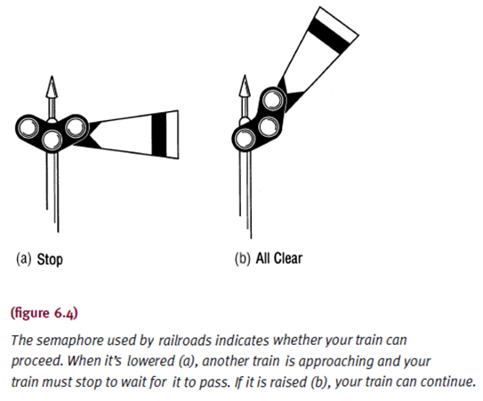
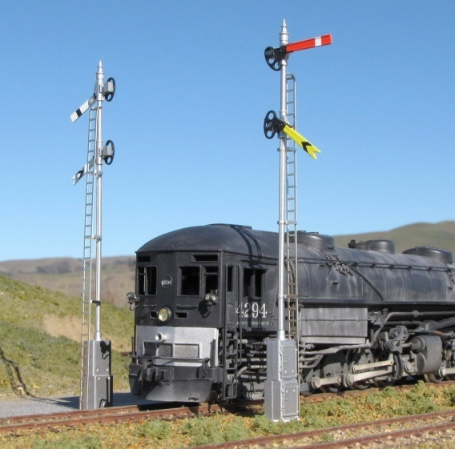
Semaphores
Similar function in OS i.e it signals if and when a resource is free and can be used by a process.

Slide 52
Semaphores
Semaphore in OS:
Protocol mechanism for task communication.
Specifically, semaphores are used to:
  Control access to a shared resource (mutual exclusion).
  Signal the occurrence of an event.
  Allow two tasks to synchronize their activities.

Slide 53
Semaphores
Synchronization tool that provides more sophisticated ways (than Mutex locks) for processes to synchronize their activities.
Semaphore S – integer variable
Can only be accessed via two indivisible (atomic) operations
  when one process modify semaphore variable S, then no other process can modify the variable concurrently 🡪 mutual exclusion
  wait() is called P()
  and signal() called V()

Slide 54
Semaphores
Definition of the wait() operation
  wait(S)
  { while (S <= 0) ; // busy waiting
  S = S - 1;
  }
  (S <= 0 implies busy critical section/region or a process in CS)
  (Process calling on wait() operation must wait until S > 0 (+ve value))
Definition of the signal() operation
  signal(S)
  {
  S = S + 1;
  }

Slide 55
Types of Semaphores
Counting semaphore – integer value can range over an unrestricted domain
Binary semaphore – integer value can range only between 0 and 1
  Same as a mutex lock
Can implement a counting semaphore S as a binary semaphore

Slide 56
Semaphore Usage
Can solve various synchronization problems
A solution to the CS problem.
  Create a semaphore “synch” initialized to 1
  wait(synch)
  CS
  signal(synch);

Slide 57
Semaphore Usage
Consider P₁ and P₂ that require code segment S₁ to happen before code segment S₂
  Create a semaphore “synch” initialized to 0
  P1:
  S₁;
  signal(synch);
  P2:
  wait(synch);
  S₂;
Because synch is initialized to 0, P₂ is executed only after P₁ has invoked signal(sync), which is after statement S₁ has been executed.
S <= 0 implies busy critical section/region or a process in CS

Slide 58
Semaphore Implementation: Busy waiting
Must guarantee that no two processes can execute the wait() and signal() on the same semaphore at the same time
Thus, the implementation becomes the critical section problem where the wait and signal code are placed in the critical section
This implementation is based on busy waiting in critical section implementation (that is, the code for wait() and signal())
  But implementation code is short
  Little busy waiting if critical section rarely occupied
Can we implement semaphores with no busy waiting? YES. The textbook has the answer.

Slide 59
Semaphore Implementation with no Busy Waiting
With each semaphore there is an associated waiting queue
Each entry in a waiting queue has two data items:
  value (of type integer)
  pointer to next record in the list
typedef struct{
int value;
struct process *list;
} semaphore;
Two operations:
  block – place the process invoking the operation on the appropriate waiting queue
  wakeup – remove one of processes in the waiting queue and place it in the ready queue

Slide 60
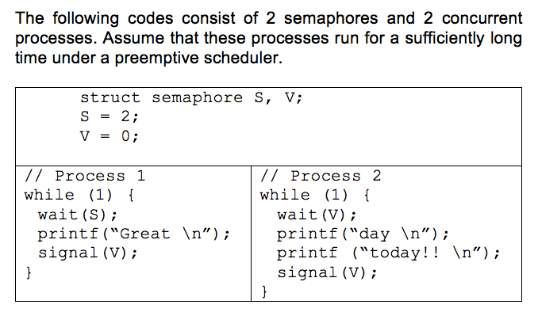
Exercise:
Continue…

Slide 61
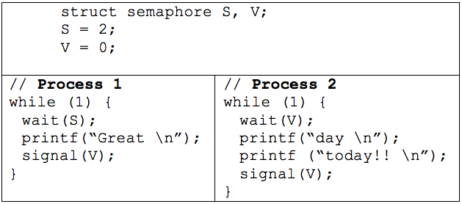
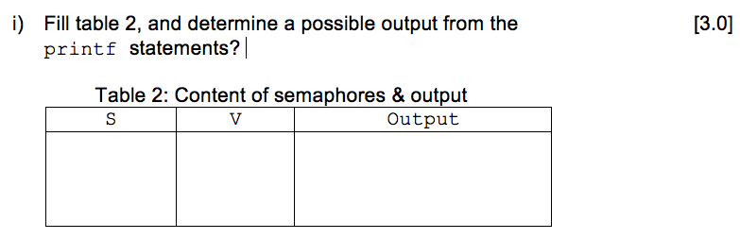

Slide 62
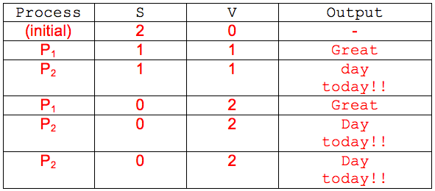
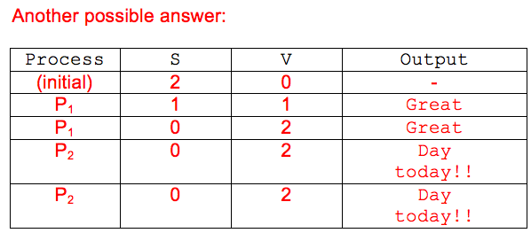

Slide 63
Example: Producer-Consumer Problem
Initial values: mutex = 1, empty = n, full = 0
Producer
do {
….
produce an item in nextp
….
wait(empty); //dec empty cnt
wait(mutex);
….
add nextp to buffer
….
signal(mutex);
signal(full);//inc full cnt
} while (TRUE);
Consumer
do {
wait(full); //dec full cnt
wait(mutex);
…..
remove an item from buffer to nextc
….
signal(mutex);
signal(empty); //inc empty cnt
….
consume the item in nextc
….
} while (TRUE);

Slide 64
Exercise:
Based on the previous example, fill in the following table with the value of those variables used.
Assume that initial value:
mutex = 1, empty = 5, full = 0
Producer :
 | wait() | signal()
empty
mutex
full
Consumer :
 | wait() | signal()
empty
mutex
full

Slide 65
The producer will start first since wait(empty=5) and consumer with wait(full=0)
Once producer update full=1, then consumer proceed with all updated value by producer.
Producer :
 | wait() | signal()
empty
mutex
full
Consumer :
 | wait() | signal()
empty
mutex
full

Slide 66
Initial value: mutex = 1, empty = 5, full = 0
wait(empty=5)
empty=4
wait(mutex=1)
mutex=0
wait(full=1)
full=0
wait(mutex=1)
mutex=0
signal(mutex=0)
mutex=1
signal(full=0)
full=1
signal(mutex=0)
mutex=1
signal(empty=4)
empty=5
Producer :
 | wait() | signal()
empty
mutex
full
Producer :
 | wait() | signal()
empty | 4
mutex | 0 | 1
full |  | 1
Consumer :
 | wait() | signal()
empty
mutex
full
Consumer :
 | wait() | signal()
empty |  | 5
mutex | 0 | 1
full | 0

Slide 67
6.6.3 Deadlock and Starvation
Incorrect use of semaphore operations can produced:
  Deadlock – two or more processes are waiting indefinitely for an event that can be caused by only one of the waiting processes
  Starvation – indefinite blocking
    A process may never be removed from the semaphore queue in which it is suspended

Slide 68
Summary
Mutual exclusion
  Prevents deadlock
  Maintained with test-and-set, WAIT and SIGNAL, and semaphores (P, V, and mutex)
Synchronize processes using hardware and software mechanisms

Slide 69
EXERCISE (DIY!!!)
Figure 1 shows the implementation of Producer-Consumer using Semaphores. Supposed the initial values of the buffer size, N=8, mutex=1, empty=6 and full=2.
Complete the value of the appropriate mutex variables in Table below if the following sequence of order is executed: consumer, consumer, producer. [6 marks]
Process | Wait(full) | Wait(mutex) | Signal (mutex) | Signal (empty)
Initia Value | 2 | 1 |  | 6
Consumer
Consumer
Process | Wait(empty) | Wait(mutex) | Signal (mutex) | Signal (full)
Producer

Slide 70
End of Chapter 6

